Slide 1
Use of the Photovoice Method in Scientific Research
INFT 4017 Research Methods
DO NOT REMOVE THIS NOTICE. Reproduced and communicated on behalf of the University of South Australia pursuant to Part VB of the copyright Act 1968 (the Act) or with permission of the copyright owner on (DATE) Any further reproduction or communication of this material by you may be the subject of copyright protection under the Act. DO NOT REMOVE THIS NOTICE.

Slide 2
Outline
Introduction
Our study on immigrants’ information behaviour using photovoice
Some reflections: strengths, challenges and notes

Slide 3

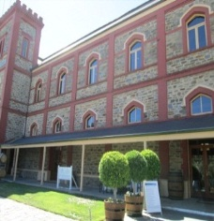
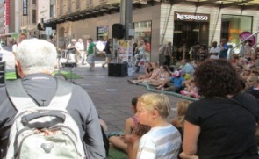

What is photovoice?
Photovoice was developed in rural China in 1992 by Caroline Wang and Mary Ann Burris, giving voice to the disadvantaged.
Photovoice refers to documentary photography techniques representing societal realities.
In photovoice, the images used in the interviews are generated by participants.
Photovoice requires community participation and emphasizes on affecting social change.

Slide 4
Photovoice is a participatory action research strategy (Wang, 1999).
Photovoice has three main goals (Wang & Burris, 1997, p. 370):
1. to enable people to record and reflect their community’s strengths and concerns;
2. to promote critical dialogue and knowledge about important issues through large and small group discussion of photographs;
3. to reach policymakers.

Slide 5
Five key concepts in photovoice (Wang, 1999)
Concept 1: Images teach
(relying on how people interpret the image)
Concept 2: Pictures can influence policy
(influence our focus and our world view)
Concept 3: Community people ought to participate in creating and defining the images that shape healthful public policy
(people do define images in addition to creating them, with discussions and interpreting)
Concept 4: The process requires that planners bring to the table from the outset policymakers and other influential people to serve as an audience for community people’s perspectives
(how photos can influence policy?)
Concept 5: Photovoice emphasizes individual and community action
(unique and important characteristics of photovocie)

Slide 6
Four practical stages of photovice (Given et al., 2011):
Stage 1: Recruitment and Theme Building
(‘community-buy-in’ phase, jointly determining the initial themes)
Stage 2: Training and Picture Taking
(technical consideration, information/training sessions)
Stage 3: Photo Selection Focus Groups and Analysis
(discussions allowing the common themes and concepts identified)
Stage 4: Results and Community Change
(beyond typical academic venues, inform stakeholder communities)

Slide 7
Photovoice in various projects
Photovoice has proven to be a method for engaging groups who may have difficulty articulating their views in traditional research (e.g., homeless, second language learners, indigenous people), thus increasing the scope of potential participants.

Slide 8
A photovoice exploration of homeless women’s health and lives (Bukowski et al., 2011)
Using photovoice with older adults (Novek et al., 2012)
Exploring Nigerian immigrants’ eating and physical activity in the US (Turk et al., 2015)
Assessing the long-term impact of a disaster on a community’s quality of life (Annang et al., 2016)

Slide 9
Photovoice in information studies
Photovoice facilitates participant involvement at all stages of the research process.
In a recent study of refugees living in Salt Lake City, photovoice was used as “a method of sharing power” without causing harm to anyone (Lambert, 2014).
Photovoice as used in an ongoing longitudinal research study assessing the information literacy skills of students as they transition from high school to university in Canada (Given et al., 2011).

Slide 10
Web resources
http://photovoice.ca/
Photovoice – capture your story and share your vision.
The Photovoice Manual
https://photovoice.org/
http://www.photovoiceworldwide.com/

Slide 11
Our study
Using photovoice to capture and understand Asian immigrants’ information behaviour during their settlement in South Australia (Khoir et al. 2015).
Information behaviour describes the way in which humans seek, manage, and use information in diverse contexts to meet their information needs (Pettigrew, Fidel, & Bruce, 2001; Wilson, 2000).
The various aspects of human–information as immigrants settle in a new country.

Slide 12

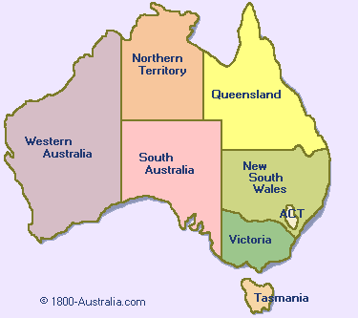
Study background
Immigrants accounting for 27% of Australian population (source: Australian Bureau of Statistics , 2016)
24 million
2016
35
countries
1 out of 3 is immigrant
6.5 million
27%

Slide 13
South Australia Facts
1.6 million
South Australia
Adelaide
26.7%
immigrants
18 wine
regions
19.8%
Asian
5th most livable
city in the world
2013
The Economist Intelligence Unit
Top 5
India
China
Vietnam
Philippines
Malaysia

Slide 14
The Australian census
(Khoir et al. 2015)

Slide 15
Research aims
To examine Asian immigrants’ information behaviour in everyday life in South Australia during their settlement process, including
information needs
information seeking
information sharing
information grounds
how these information grounds prompt their sharing of information

Slide 16
Methods
Study Participants
International immigrants defined by Caidi et al. (2010)
Adult Asian immigrants from top 5 Asian immigration countries
18-25 (15%), 26-45(68%), 46-55(14%)
Both newcomers and the long-established

Slide 17
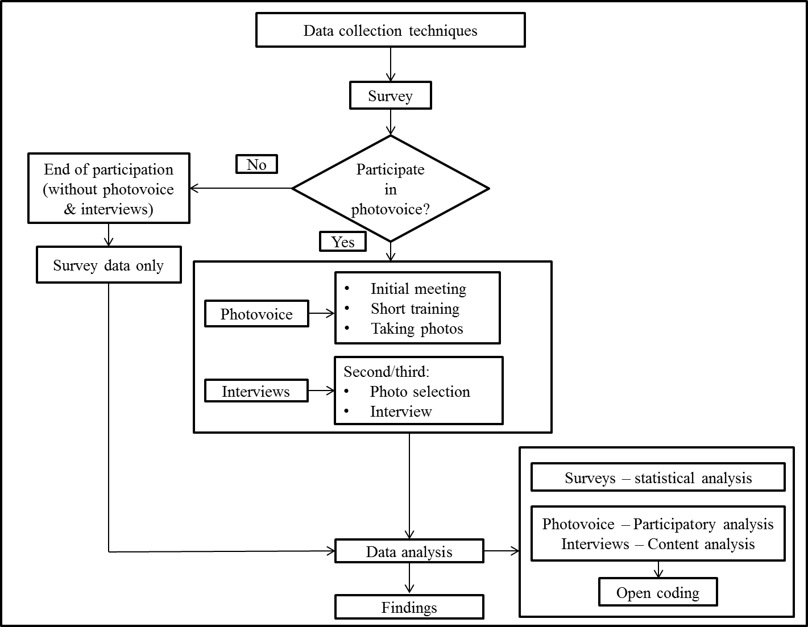

Slide 18
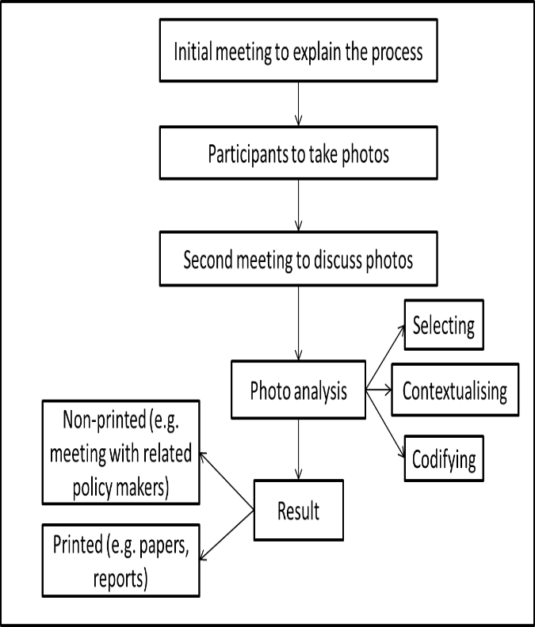
The process of using photovoice method

Slide 19

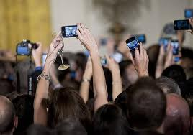
How Photovoice?
Initial meeting (by phone or face-to-face)
Picture-taking explanation (Providing samples, discussions on initial themes, decision on using mobile phones with camera feature)
Ethical issues
Each with 5-10 pictures in 5-7 days
258 photo results discussion in interviews

Slide 20
What to capture? --- The selection of photos
Everyday life photos
Information needs during migration settlement
Information sources in satisfying needs
Barriers and challenges in information seeking activities
Public library services used
Anything of interest around the process of information gathering or sharing

Slide 21
Photo analysis
258 photos captured by study participants’ mobile phones
Participatory analysis (Wang & Burris, 1997)
Selecting
Contextualizing
Codifying
The involvement of participants is a main part of the analysis process.

Slide 22
Category/Theme | Description of category | No. of photos
Information sources | Reflecting various kinds of sources that immigrants access | 58
Information grounds and sharing | Referring to the places (both virtual and physical) where immigrants meet and share information | 40
Information needs | Coding the information that immigrants look for in the process of settlement. | 33
Challenges | Depicting what immigrants feel challenged by | 29
Community life | Referring to a group/ association that immigrants join, things they contribute to, and community activities | 23
Public library services | Categorising libraries immigrants visit and services they use | 18
Achievement | Coding what immigrants achieve and the culture/tradition they preserve in a new country | 17
Entertainment and leisure | Referring to something of interest, such as festivals or places. | 16
Communication tools | Classifying tools that immigrants use to communicate to other people | 9
Others | Categorising other stories that not directly related to the study theme | 15
Total photos |  | 258

Slide 23
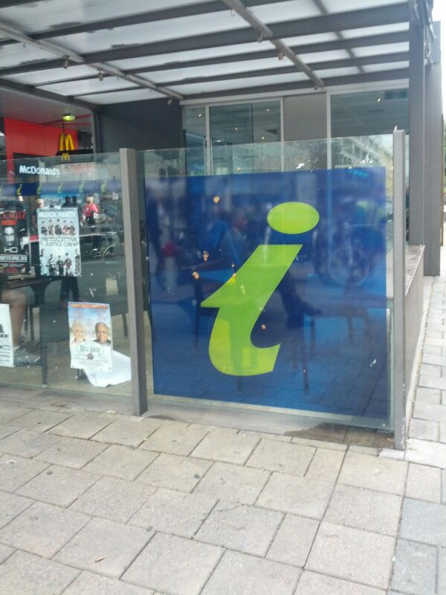
What study participants said from photos: (Information source)
Where they went to find information

Slide 24

A South Australian Government website

Slide 25
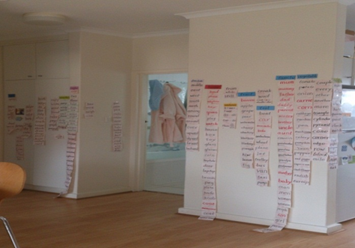
What study participants said from photos: (Information needs)
A Chinese mother teaches her daughter English at home

Slide 26
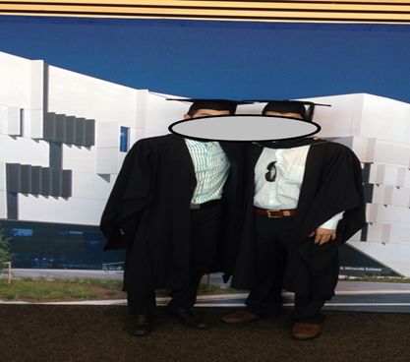
Graduation: To celebrate or worry?

Slide 27
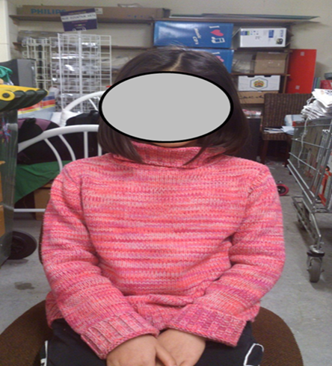
A parent’s employment leaves a lonely daughter

Slide 28
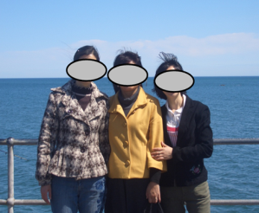
Friends from the same country

Slide 29

What study participants said from photos (barriers)
Accommodation is one of the challenges

Slide 30
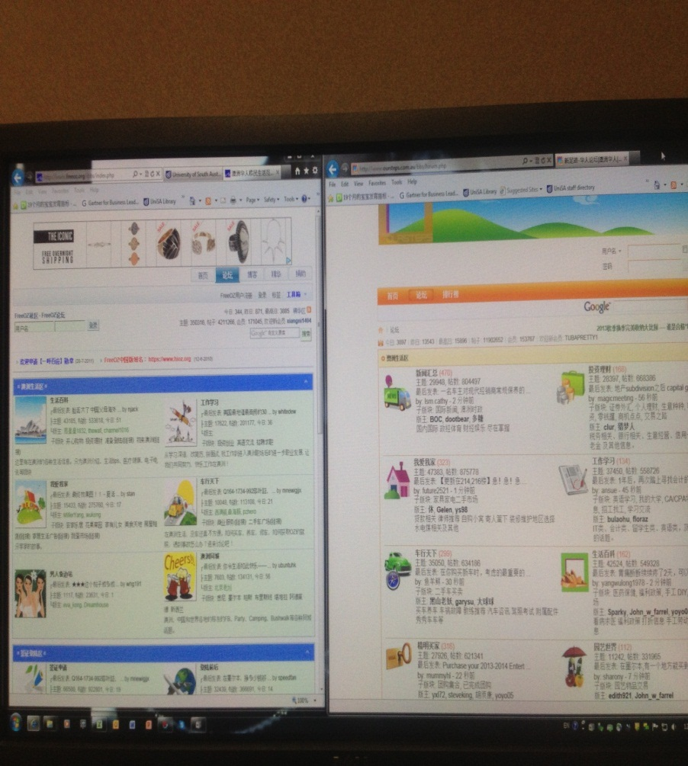
What study participants said from photos (Information sharing and information ground)
How immigrants socialise through social media with their networks in their home country

Slide 31
Reflections
Photovoice: Providing an element of control to the participants
The combination of photo-taking, photo-selection and photo-based interviews was a way of inviting participants to open up and share their experiences.
It provides a channel between the participants and the researcher that goes towards overcoming the language and cultural differences.
Some photos were taken specifically for the study, while some were stored photos in the album in their phones or computers.

Slide 32
It is beneficial to be used together with other methods.
The major strength of photovoice is that it elicited information and data that would not be available from the sole application of either a survey or an interview.

Slide 33
Strengths
Enables more comprehensive results
Elicits stories about capabilities as well as concerns
Mobile phones are handier for ordinary people without special photographic skills.
Contextual information about information behaviour --- what, where, which, why, and how
See examples 1 and 2 in next slides

Slide 34
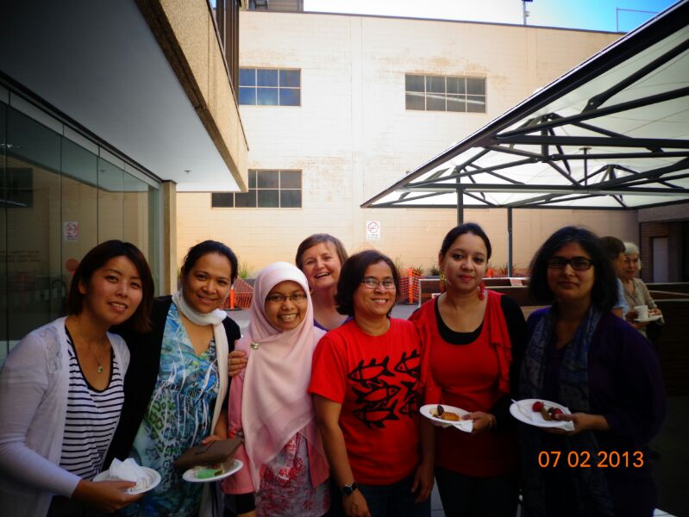
Example 1 “International gathering in university”
Share and exchange information and other ideas in the gathering activity
Informal situation makes immigrants feel more comfortable
Chance to continue in other relationships (e.g for the future references, jobs, other information)
Respect the different culture in Australia
Chance to meet and be friend with people from other countries
The networks as one of the information sources

Slide 35
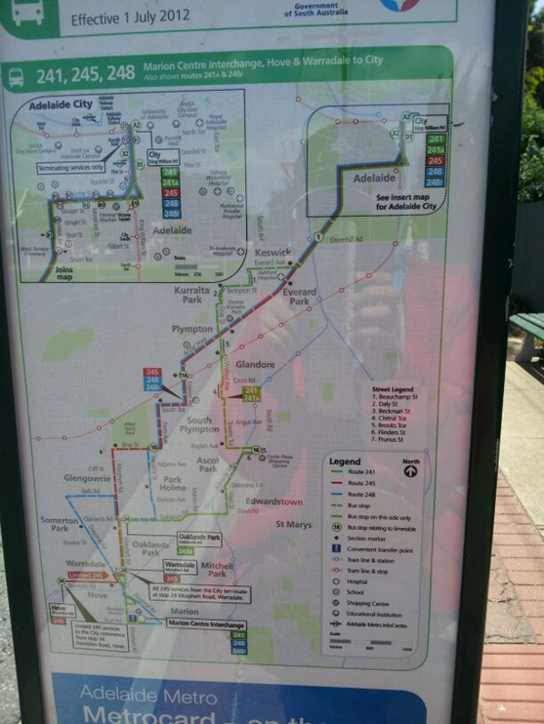
Example 2 – “Road and bus map”
Learning many things in the transportation system such as priority seats, on board tickets versus Metrocard, card reload
Get lost many times
Vietnamese interpreter is available through the call centre
Map reading: The biggest challenges during the first days
Multilanguage maps should be available
Printed and online maps were reliable

Slide 36
Study participants felt great involvement to the research project
Lower research cost
Overcoming language barriers
Access to the participant’s priorities and the inclusion of emotion
Enabling triangulation with data collected from other sources
Advertise the research aims and goals to a wider community

Slide 37
Challenges
Ethical issues (for both photovoice participants and researchers, privacy protection)
Unclear photo results
Irrelevant pictures with the project themes
New to participants – more training needed
Reminders needed to the participants
The need for interpretation

Slide 38
Conclusion and next step
Photovoice is substantial to explore information behaviour more comprehensively
Mobile phones play an important role
Inform public library services design and delivery in South Australia

Slide 39
References
Hartel, J., & Thomson, L. (2011). Visual approaches and photography for the study of immediate information space. Journal of the American Society for Information Science and Technology, 62(11), 2214-2224.
Julien, H., Given, L. M., & Opryshko, A. (2012). Photovoice: A promising method for studies of individuals' information practices. LISR.
Khoir, S., Du, J. T., & Koronios, A. (2015). Everyday information behaviour of Asian immigrants in South Australia: A mixed-methods exploration. Information Research (IR), 20(3), paper 687.
Wang, C., & Burris, M. A. (1994). Empowerment through photo novella: Portraits of participation. Health Education Quarterly, 21(2), 171-186.
Wang, C., & Burris, M. A. (1997). Photovoice: Concept, methodology, and use for participatory needs assessment. Health Education & Behavior, 24(3), 369-387.

